Slide 1
Lip Reading Optimization
Samuel Youssef · Jason Chou · Maleye Diakhate
Professor George Wolberg
Senior Project II - 05/08/2019

Slide 2
Goal
The overall goal of this project was to improve an existing lipreading model LipNet
We accomplish this by
implementing an unmaintained method of curriculum training that speeds up convergence
modifying hyperparameters of the model so that it can more easily accept variations in datasets
As a byproduct of this work, we also streamlined the interface for the model for training a variety of different video formats and deployed it on the cloud for scalable processing.

Slide 3
Predict Demo
python –m SimpleHttpServer:8080
./predict
~/LipNet/training/random_split/results/resumrun2/weights781.h5
~/LipNet/test_vid/json-bb1
~/GRID/s9/pwwi4n.mpg
~/GRID/s5/lwik4n.mpg
~/id2_vcd_swwp2s.mpg

Slide 4
Related Work
3D CNNs for Cross AVR Matching
LipNet: End-to-End Sentence-Level Lipreading
Lip Reading in the Wild
Lip Reading Sentences in the Wild

Slide 5
Overview
Neural Network Structure
CNNs, RNNs, CTC Loss
LipNet
Training Implementation
Cloud Computing Platforms
Data Processing
Training Curriculums
Results
Training
Prediction

Slide 6
Neural Network Structure
CNNs, RNNs, CTC Loss, LipNet

Slide 7
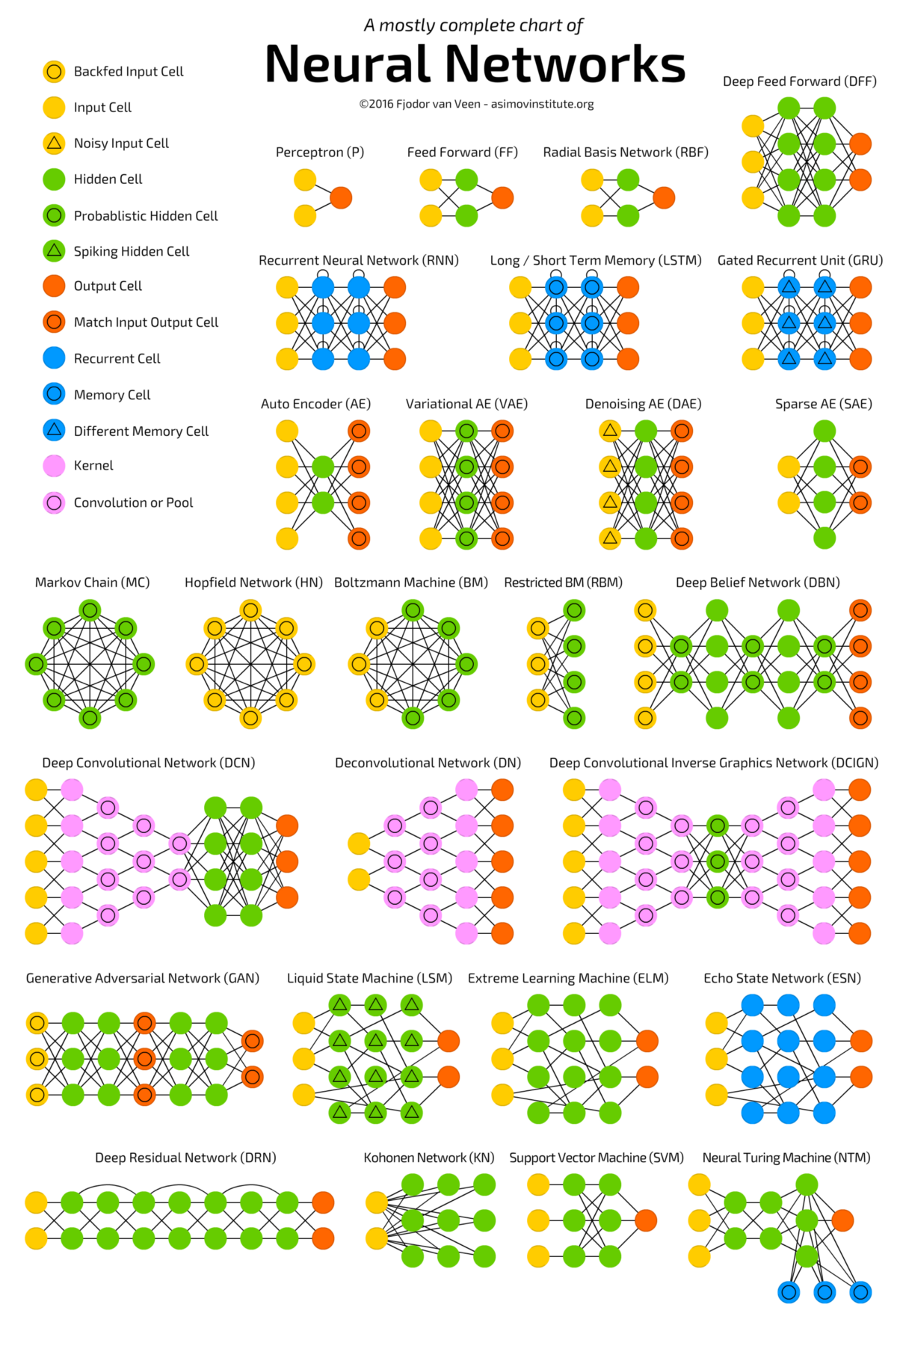
Neural Network Structures

Slide 8
Convolutional Neural Networks (CNNs)
convolutional neural network are a class of deep neural networks, most commonly applied to analyze visual imagery
in LipNet, we used a 3D CNN to analyze our videos using their frames
we used 3 convolutions as shown below. Spatiotemporal CNNs are used to extract features from visual frames with respect to time and space.

Slide 9
Recurrent Neural Network (RNN)
a recurrent neural network (RNN) is a class of artificial neural network that exhibits temporal dynamic behavior. RNNs use their internal states (memory) to process sequences of inputs
RNNs can be achieved by either using Gated Recurrent Units or Long Short-Term Memory

Slide 10
Connectionist Temporal Classification (CTC)
Connectionist Temporal Classification is a type of neural network output associated with a scoring function
It is used to train RNN such as Gated Recurrent Units or Long Short-Term Memory. It is usually used when time is variable as well as recognizing phonemes in speech recognition

Slide 11
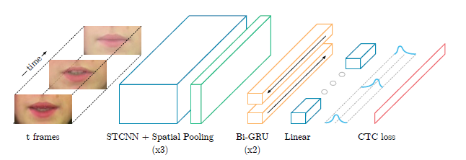
LipNet Structure

Slide 12
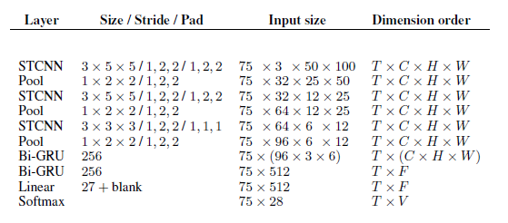

Slide 13
LipNet Hyperparameters
filters (32 for conv1, 64 for conv2, and 96 for conv3) - it is an integer, the dimensionality of the output space or number of filters in the convolution
kernel_size - List of 3 integers specifying the depth, height, and width of the 3D convolution window. It is (3,5,5) for conv1 and conv2 but (3,3,3) for conv3
strides - list of 3 integers specifying the strides of the convolution along the depth, height, and width
activation - activation function
kernel_initializer - an initializer for the kernel function

Slide 14
Training Implementation
Cloud Computing Platforms, Data Processing, Training Curriculums

Slide 15
Training Demo
python scripts/extract_mouth_batch.py
/path/to/videos/*.mpg
/TARGET
/path/to/face
python make_dictionary.py
/path/to/aligns
/path/to/vids
./train

Slide 16
Cloud Computing Platforms
Amazon EC2
Amazon SageMaker
Google Cloud Platform
Note: Comparisons will be between the free tiers of each service

Slide 17
Amazon EC2
Pros
Cons
easily accessible
1 vCPU
1GB RAM
needs specific user credentials

Slide 18
Amazon SageMaker
Pros
Cons
preconfigured environments for machine learning
notebook format for convenient output
4 GB RAM
harder to get external dependencies set up
needs specific user credentials

Slide 19
Google Cloud Platform
Pros
Cons
large amounts of credits
GPU support

Slide 20
GPUs
We used a GPU

Slide 21
Datasets
GRID
The Oxford-BBC Lip Reading in the Wild (LRW) Dataset
Lip Reading Sentences 3 (LRS3) Dataset

Slide 22
Datasets (cont.)
GRID
LRW
Artificial
Length: medium
TED and TEDx Talks
LRS
Length: long
Length: short
BBC Newscasts

Slide 23
GRID Format
{bin, lay, place, set}
{blue, green, red, white}
{at, by, in, with}
{A, . . . , Z}
{zero, . . . , nine}
{again, now, please, soon}

Slide 24
Alignment and Dictionary
Supervised learning

Slide 25
Failed Approach: LRW
Words were not properly documented so reliable align and dictionary files couldn’t be generated

Slide 26
Failed Approach: LRS
Sentences were too long
Spread the sentences out

Slide 27
Improvements to GRID Processing
Training on smaller datasets

Slide 28
Training Curriculums
Overlapped Speaker
Random Split

Slide 29
Overlapped Speaker
By training on each speaker separately, the overlapped speaker script that has been developed by rizkiarm has a curriculum of learning that uses a whole sentence to validate. While we found problems with this specific learning curriculum when we tried to use it to maintain the random-split script, LipNet developers have found that it only takes 368 epochs to get to a weights file that achieves a 96.93% BLEU score, 1.56% character-error rate, and 3.38% word-error rate. While our work on the random-split script involved many different aspects which were taken into consideration, the random-split and overlapped speaker scripts do have a lot in common.

Slide 30
Random Split
Training on multiple speakers at the same time is the main difference between random-split script and overlapped speaker script. The idea behind the random-split script is simple. Derived from its name, the script splits the dataset [might be data from different speakers] into two groups: 80% for training and 20% for validation [these percentages can be easily changed]. The original script used learning curriculum that start validating on a whole sentence from epoch 0 which we found problematic when we attempted to train on various speakers.

Slide 31
Results
Training Results, Prediction Results

Slide 32
Metrics
Character Error Rate - Character Error is a common metric performance of a speech recognition system. It allows us to obtain the error of the models made while decrypting characters.
Word Error Rate - The word error rate is obtained by comparing our prediction from our model to the actual word within the datasets.
BLEU Score - BLEU (bilingual evaluation understudy) is a metric for evaluating a generated sentence to a reference sentence.

Slide 33
Graphs…

